Slide 1

Natural Language Processing
Yue Zhang
Westlake University

Slide 2
Chapter 3
Feature Vector

Slide 3
Contents
3.1 Representing Documents in Vector Spaces
3.1.1 Clustering
3.1.2 K-Means Clustering
3.1.3 Classification
3.1.4 Support Vector Machine
3.1.5 Perceptron
3.2 Multi-class Classification
3.2.1 Defining Output-based Features
3.2.2 Multi-class SVM
3.3.3 Multi-class Perceptron
3.3 Discriminative Models and Features
3.3.1 Discriminative Models and Features
3.3.2 Dot-product Form of Linear Models
3.3.3 Separability and Generalizability
3.3.4 Dealing with Non-linearly-separable data

Slide 4
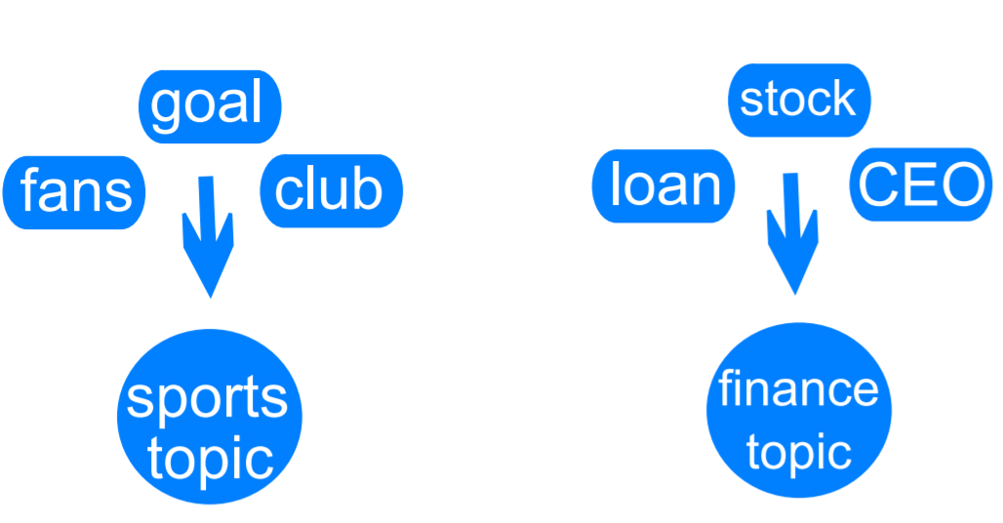
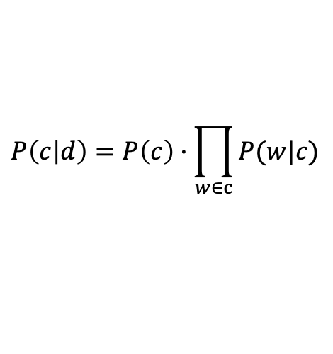
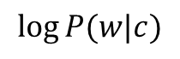
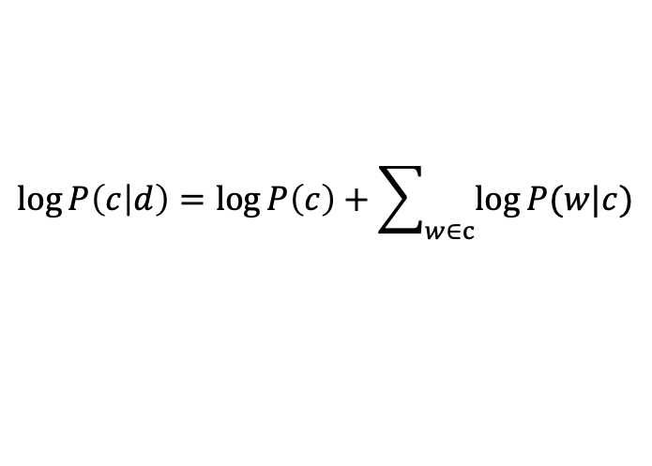
Review Naïve Bayes
$$P\left(c | d\right)=P\left(c\right)·\prod_{w∈c}{P(w|c)}$$
$$\log{P\left(c | d\right)}=\log{P\left(c\right)}+\sum_{w∈c}{\log{P(w|c)}}$$
Words as features
$$\log{P(w|c)}$$

Slide 5
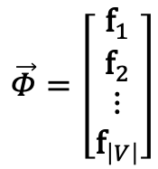
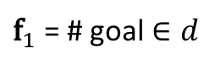
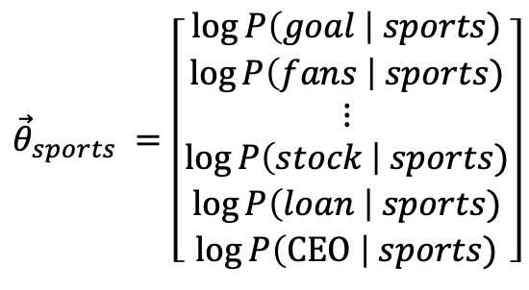
Feature vectors
$${\vec{θ}}_{sports} =\left[\begin{aligned}\begin{aligned}\log{P\left(goal \right| sports)} \\ \log{P\left(fans \right| sports)} \\ ⋮ \\ \log{P\left(stock \right| sports)} \\ \log{P\left(loan \right| sports)}\end{aligned} \\ \log{P\left(\text{CEO} \right| sports)}\end{aligned}\right]$$
$$\vec{Φ}=\left[\begin{aligned}{\text{f}}_{1} \\ {\text{f}}_{2} \\ ⋮ \\ {\text{f}}_{\left|V\right|}\end{aligned}\right]$$
${\text{f}}_{1}$ = # goal $∈d$
$$\log{P\left(c=sports | d\right)}={\vec{θ}}_{sports}∙\vec{Φ}+\log{P\left(c=sports\right)}$$

Slide 6
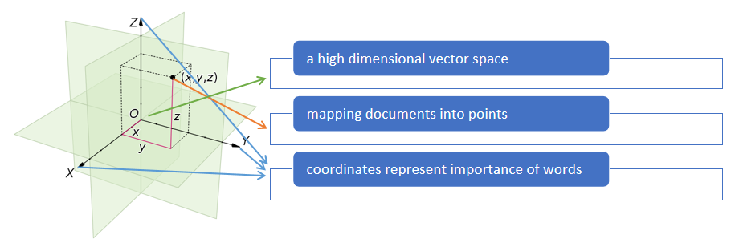
Vector Space Model
Mapping documents to vectors
(unstructured texts into mathematical structures)

Slide 7
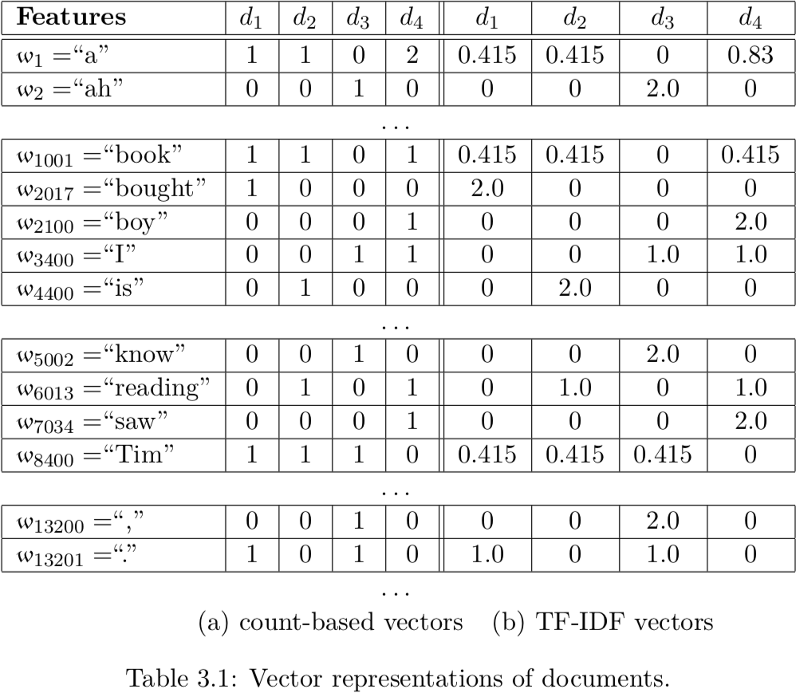
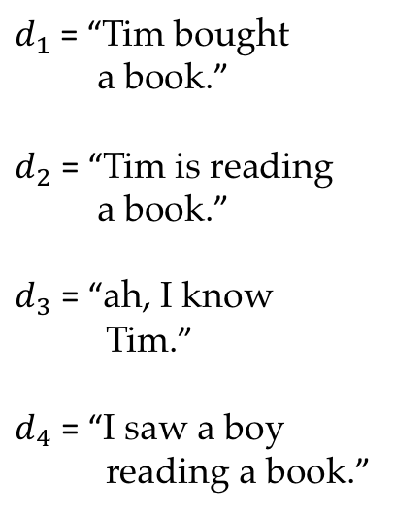
Vector representation of documents
$d_{1}$ = “Tim bought
a book.”
$d_{2}$ = “Tim is reading
a book.”
$d_{3}$ = “ah, I know
Tim.”
$d_{4}$ = “I saw a boy
reading a book.”
Notes:
table 3.1

Slide 8
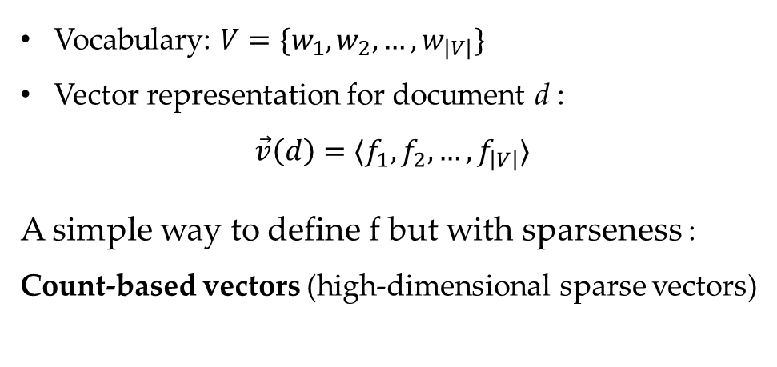
Sparse vectors document representation
Vocabulary: $V=\{w_{1},w_{2},…,w_{\left|V\right|}\}$
Vector representation for document d :
$$\vec{v}\left(d\right)=⟨f_{1},f_{2},…,f_{\left|V\right|}⟩$$
A simple way to define f but with sparseness :
Count-based vectors (high-dimensional sparse vectors)

Slide 9
Stop words
Frequent yet uninformative
Common stop words in English
∣ a ∣ the ∣ on ∣ of ∣ with ∣ about ∣ and ∣ in ∣ at ∣ to ∣ " ∣, ∣?∣ oh ∣ . ∣
Filter uninformative words
remove Stop Words from the vocabulary when mapping documents to vectors
Limitation
manually defined.

Slide 10
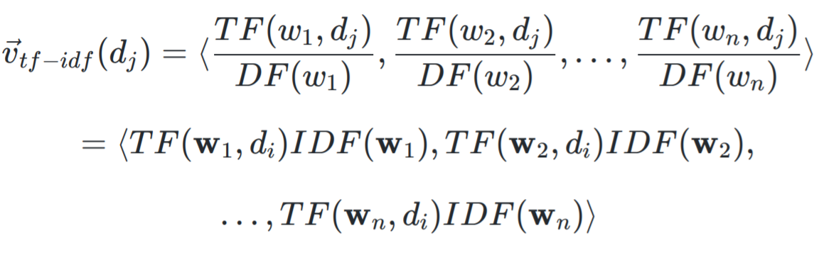
TF-IDF vectors document representation
Soft version of stop words in selecting useful words.
Intuition — the more documents in which of words exists, the less informative the word is.
reduce the importance values of uninformative words

Slide 11
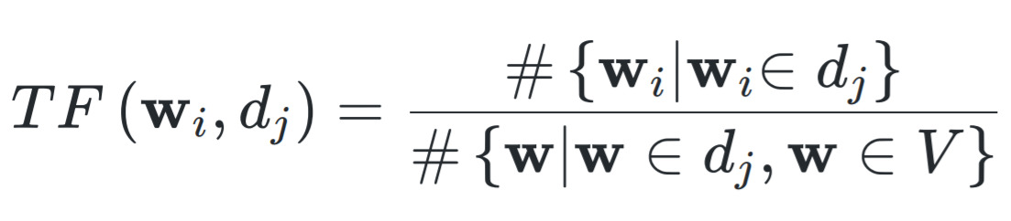
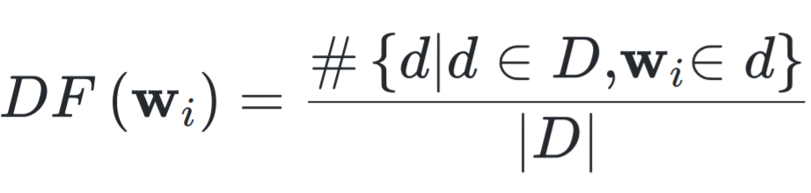
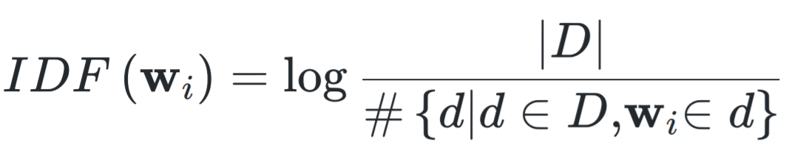
TF-IDF vectors
Soft version of stop words in selecting useful words
Term frequency (TF)
Document frequency (DF)
Inverted document frequency (IDF) (with logarithm)

Slide 12
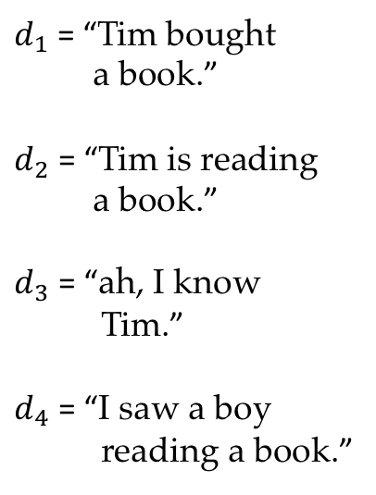
Vector representation of documents
$d_{1}$ = “Tim bought
a book.”
$d_{2}$ = “Tim is reading
a book.”
$d_{3}$ = “ah, I know
Tim.”
$d_{4}$ = “I saw a boy
reading a book.”
Notes:
table 3.1

Slide 13
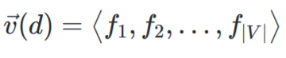
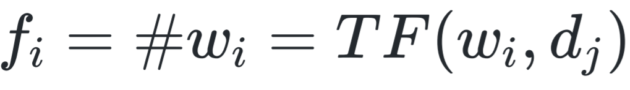
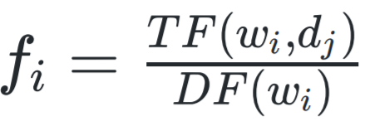
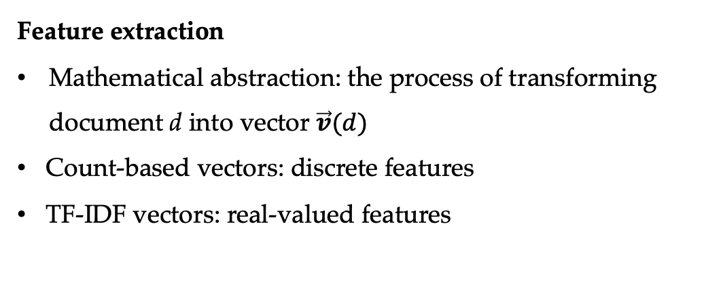
Summary
Vector representation for document d
In count-based vectors,
In TF-IDF vectors,
Feature extraction
Mathematical abstraction: the process of transforming document d into vector $\vec{v}(d)$
Count-based vectors: discrete features
TF-IDF vectors: real-valued features

Slide 14
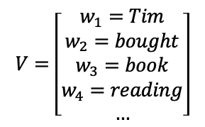
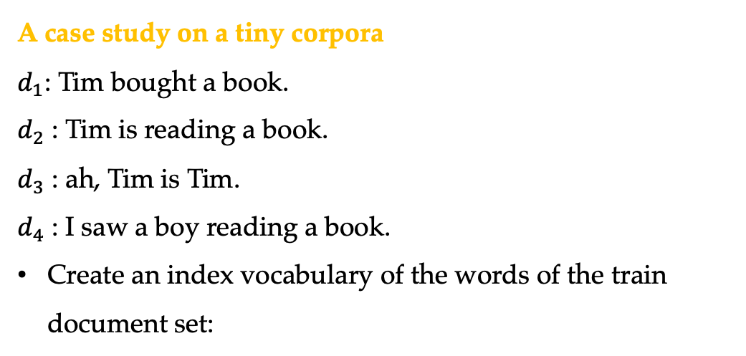
Hands on
A case study on a tiny corpora
$d_{1}$: Tim bought a book.
$d_{2}$ : Tim is reading a book.
$d_{3}$ : ah, Tim is Tim.
$d_{4}$ : I saw a boy reading a book.
Create an index vocabulary of the words of the train document set:
$$V=\left[\begin{matrix}w_{1}=Tim \\ w_{2}=bought \\ w_{3}=book \\ \begin{aligned}w_{4}=reading \\ …\end{aligned}\end{matrix}\right]$$
* Certain stop words were ignored

Slide 15
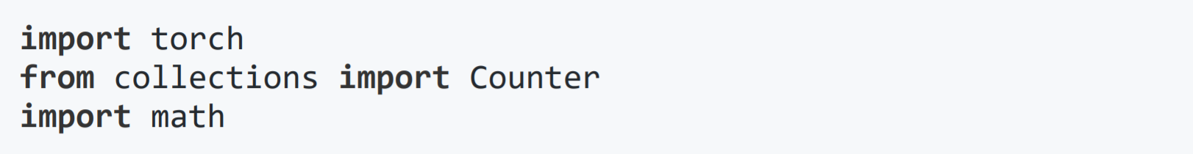
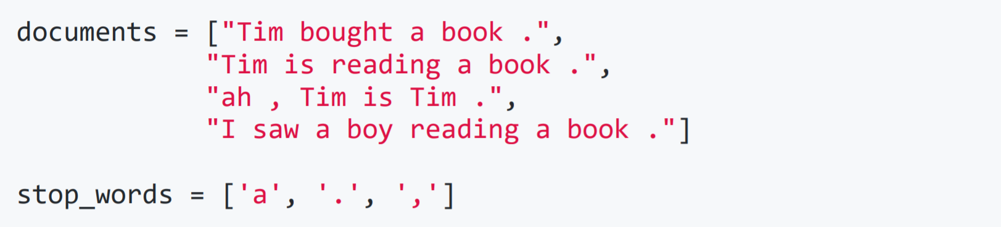
Hands on
Python practice 1
Count-based document representation.
1. Import python modules pytorch , collections and math
2. Load dataset and define the stop-words

Slide 16
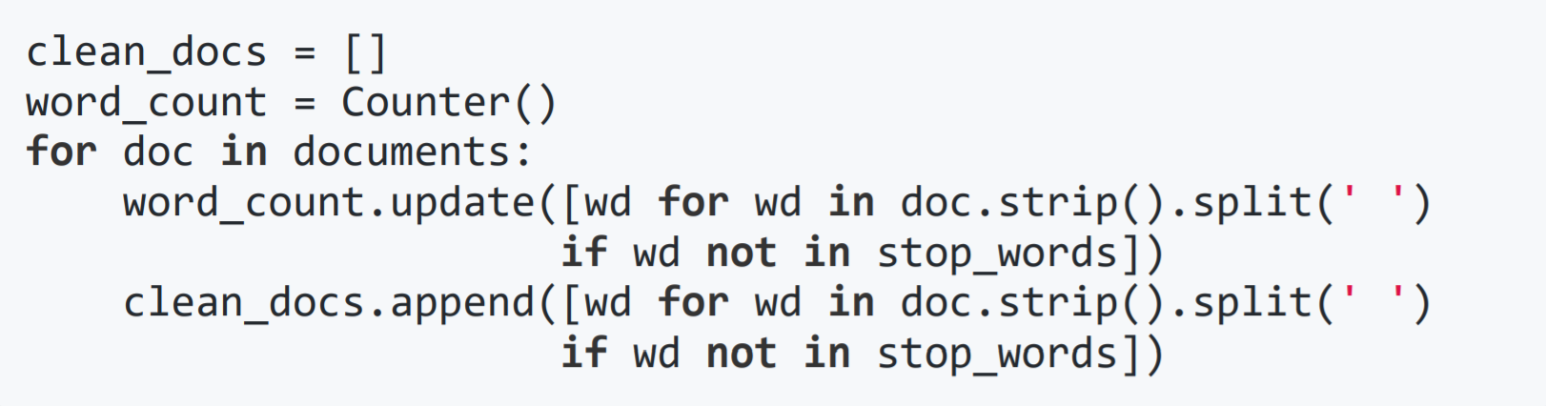
Hands on
3. Clean stop-words and count word frequency
4. Build up the vocabulary

Slide 17
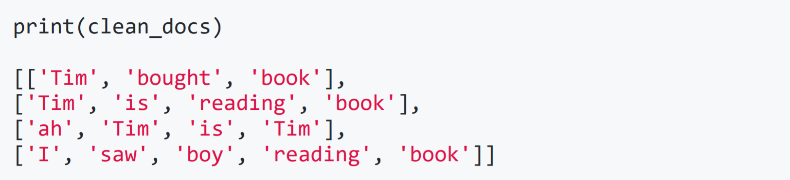
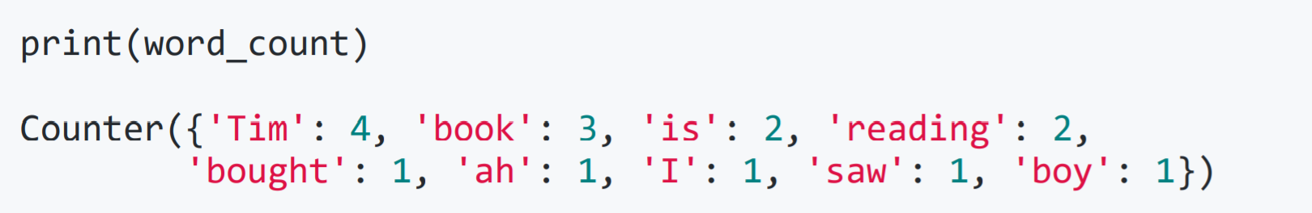
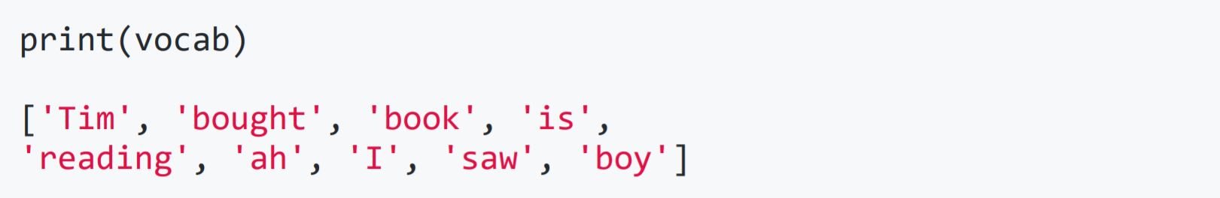
Hands on
Check the loaded data
Word count
Vocabulary

Slide 18
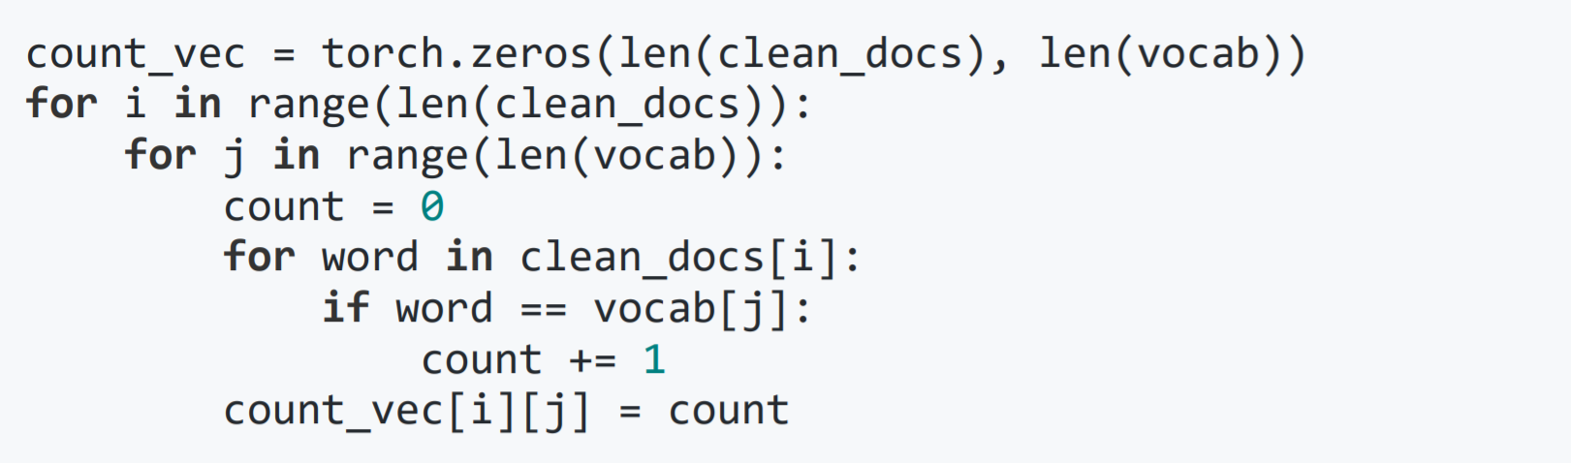
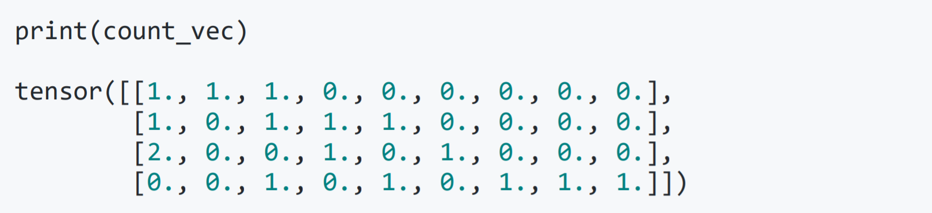
Hands on
6. Count-based document representation
Result:
Is there a soft alternative ?

Slide 19
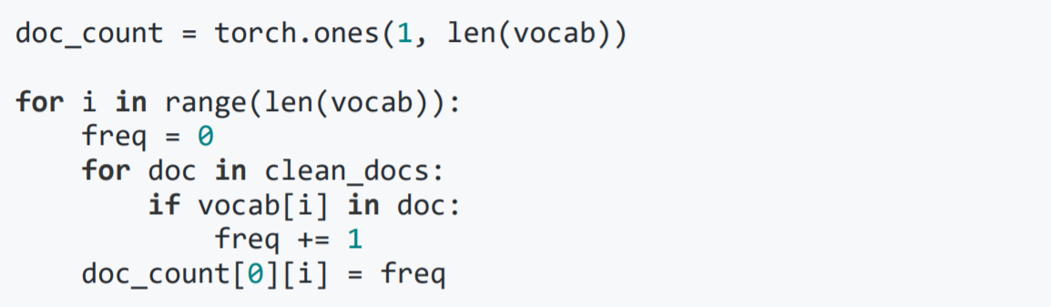
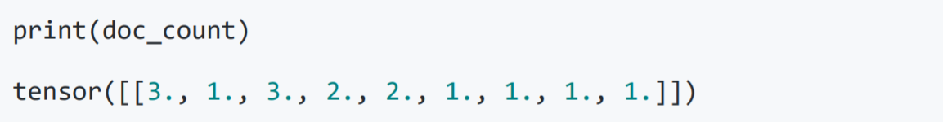
Hands on
Python practice 2
TF-IDF vectors calculation using python.
7. Count the number of documents that contain a certain
vocabulary word
* Problem set succeeded from python practice 1

Slide 20
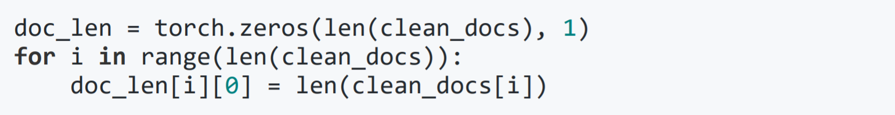
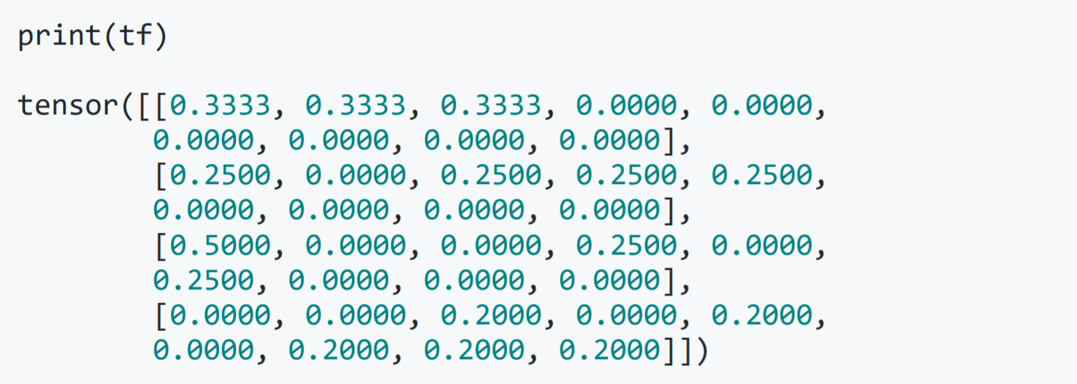
Hands on
8. Count the vocabulary words in each document
9. Calculate the term frequency
Result:

Slide 21
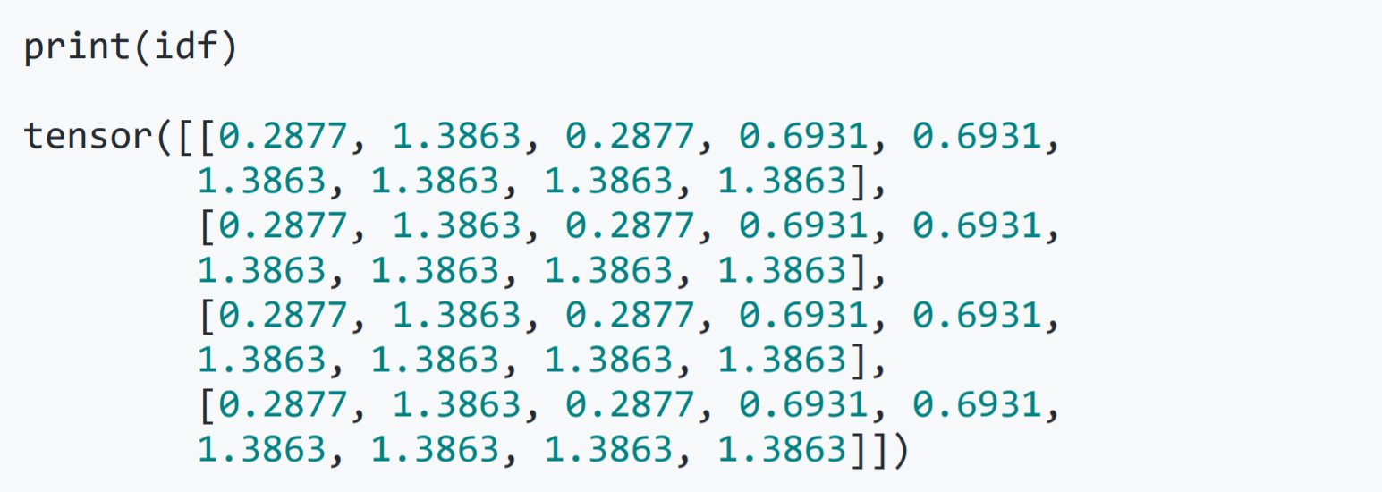
Hands on
10. Calculate the inverted document frequency
Result:

Slide 22
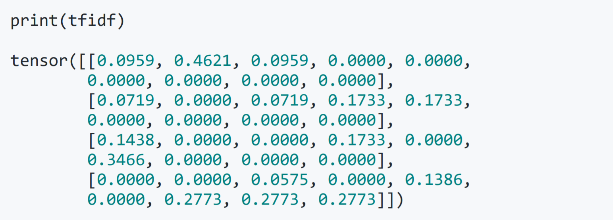
Hands on
11. TF-IDF vector document representation

Slide 23
Contents
3.1 Representing Documents in Vector Spaces
3.1.1 Clustering
3.1.2 K-Means Clustering
3.1.3 Classification
3.1.4 Support Vector Machine
3.1.5 Perceptron
3.2 Multi-class Classification
3.2.1 Defining Output-based Features
3.2.2 Multi-class SVM
3.3.3 Multi-class Perceptron
3.3 Discriminative Models and Features
3.3.1 Discriminative Models and Features
3.3.2 Dot-product Form of Linear Models
3.3.3 Separability and Generalizability
3.3.4 Dealing with Non-linearly-separable data

Slide 24
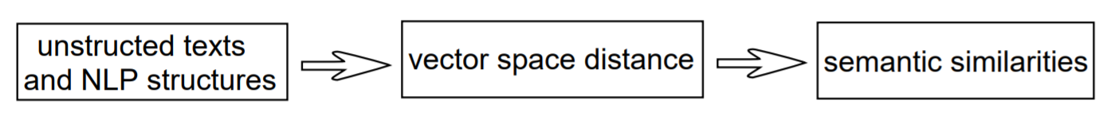
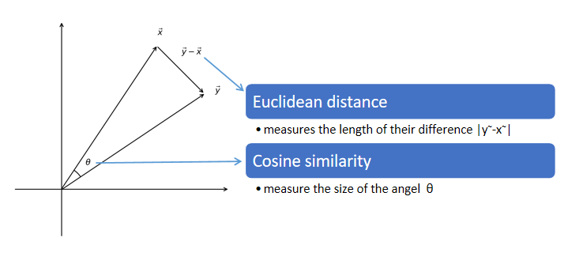
Measure vector space distance

Slide 25
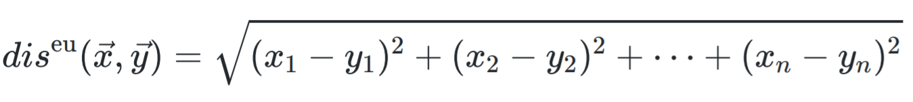
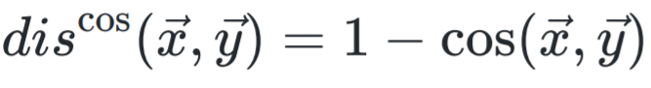
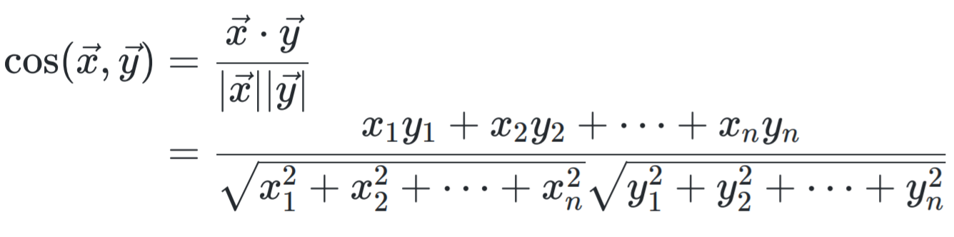
Measure vector space distance
$$\vec{X}=\left\langle x_{1}, x_{2}, …, x_{n}\right\rangle \vec{Y}=\left\langle y_{1}, y_{2}, …, y_{n}\right\rangle$$
Euclidean distance
Cosine distance
From cosine similarity

Slide 26
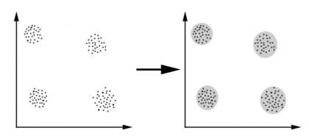
Clustering
To find groups of vectors that stay relatively close to each other, using measures of distance in vector space (Euclidean distance as the metric)

Slide 27
Contents
3.1 Representing Documents in Vector Spaces
3.1.1 Clustering
3.1.2 K-Means Clustering
3.1.3 Classification
3.1.4 Support Vector Machine
3.1.5 Perceptron
3.2 Multi-class Classification
3.2.1 Defining Output-based Features
3.2.2 Multi-class SVM
3.3.3 Multi-class Perceptron
3.3 Discriminative Models and Features
3.3.1 Discriminative Models and Features
3.3.2 Dot-product Form of Linear Models
3.3.3 Separability and Generalizability
3.3.4 Dealing with Non-linearly-separable data

Slide 28
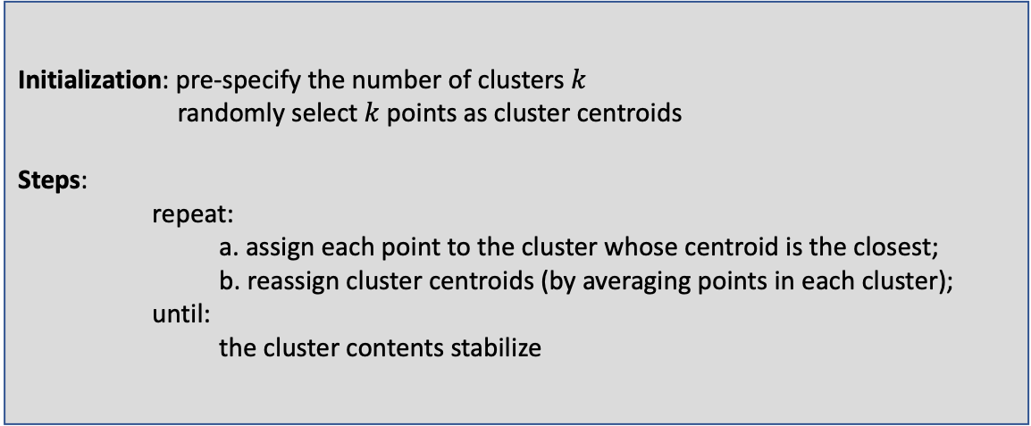
K-means clustering
Iteratively assigns points to clusters based on their distance to the centroids
Initialization: pre-specify the number of clusters $k$
randomly select $k$ points as cluster centroids
Steps:
repeat:
a. assign each point to the cluster whose centroid is the closest;
b. reassign cluster centroids (by averaging points in each cluster);
until:
the cluster contents stabilize
Notes:
algorithm 3.1

Slide 29
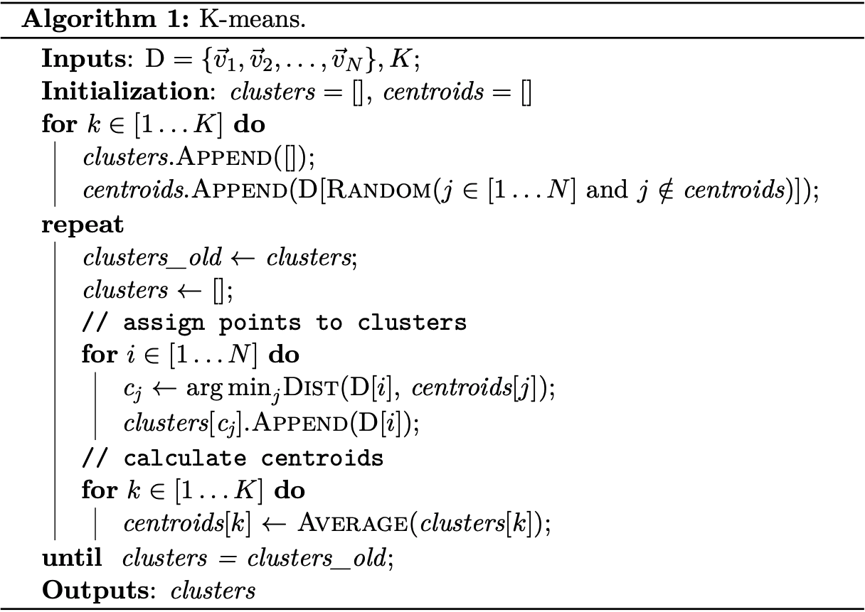
K-means clustering
Notes:
algorithm 3.1

Slide 30
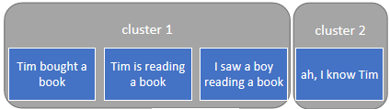



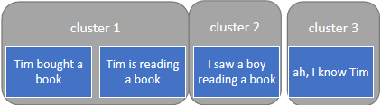

K-means clustering
2-Means
Documents
3-Means

Slide 31
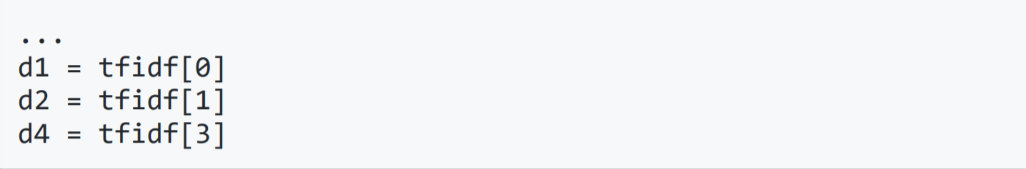
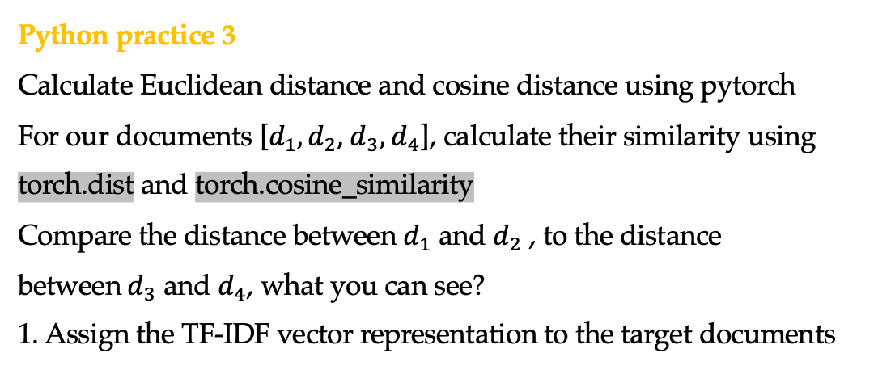
Hands on
Python practice 3
Calculate Euclidean distance and cosine distance using pytorch
For our documents [$d_{1},d_{2}$, $d_{3},$ $d_{4}$], calculate their similarity using torch.dist and torch.cosine_similarity
Compare the distance between $d_{1}$ and $d_{2}$ , to the distance between$d_{3}$ and $d_{4}$, what you can see?
1. Assign the TF-IDF vector representation to the target documents
* Problem set succeeded from python practice 1

Slide 32
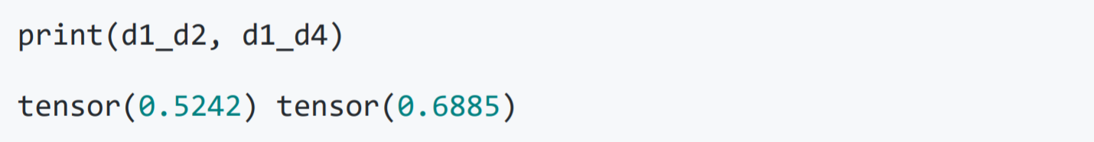
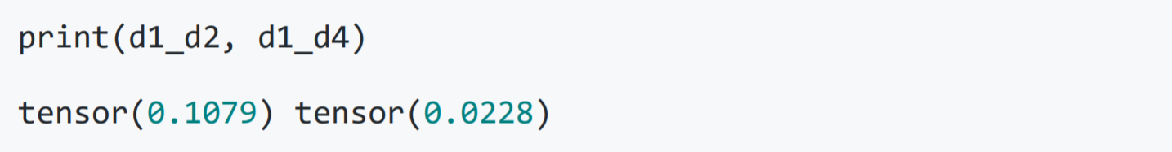
Hands on
2. Calculate Euclidean distance using the pytorch module
Result:
3. Calculate cosine distance using the pytorch module
Result:

Slide 33

Hands on
K-means clustering with python
2-means and 3-means clustering using Scikit.learn
init : method for initialization, defaults to "k-means++".
n_init : number of time the k-means algorithm will be run
with different centroid seeds.
n_jobs : the number of jobs to use for the computation.

Slide 34
Contents
3.1 Representing Documents in Vector Spaces
3.1.1 Clustering
3.1.2 K-Means Clustering
3.1.3 Classification
3.1.4 Support Vector Machine
3.1.5 Perceptron
3.2 Multi-class Classification
3.2.1 Defining Output-based Features
3.2.2 Multi-class SVM
3.3.3 Multi-class Perceptron
3.3 Discriminative Models and Features
3.3.1 Discriminative Models and Features
3.3.2 Dot-product Form of Linear Models
3.3.3 Separability and Generalizability
3.3.4 Dealing with Non-linearly-separable data

Slide 35

Clustering vs. classification
My emails
Travel Non-travel
Work
Leisure
$$d_{1} d_{2} d_{3}$$ | $$d_{4} d_{5}$$ $$d_{6} d_{7}$$
$$d_{8} d_{9}$$ $$d_{10 } d_{11}$$ | $$d_{12} d_{13} d_{14}$$ $$d_{15} d_{16}$$

Slide 36

Clustering vs. classification
Clustering vs classification.
Notes:
add example
figure 3.2
hyper-plane: generalization of a line in high-dim space

Slide 37

Clustering vs. classification
$${\vec{θ}}_{sports} =\left[\begin{aligned}\begin{aligned}\log{P\left(goal \right| sports)} \\ \log{P\left(fans \right| sports)} \\ ⋮ \\ \log{P\left(stock \right| sports)} \\ \log{P\left(loan \right| sports)}\end{aligned} \\ \log{P\left(\text{CEO} \right| sports)}\end{aligned}\right]$$
$$\vec{Φ}=\left[\begin{aligned}{\text{f}}_{1} \\ {\text{f}}_{2} \\ ⋮ \\ {\text{f}}_{\left|V\right|}\end{aligned}\right]$$
${\text{f}}_{1}$ = # goal $∈d$
$$\log{P\left(c=sports | d\right)}={\vec{θ}}_{sports}∙\vec{Φ}+\log{P\left(c=sports\right)}$$

Slide 38
Clustering vs. classification
Clustering (unsupervised learning)
Do not require manually labeled training data
All words have equal importance in a document vector
Difficult to ensure customized vector division
Classification (supervised learning)
Requires training data with manual class labels
Pick up the important words for classification tasks
Use model parameters to define space separation

Slide 39
Contents
3.1 Representing Documents in Vector Spaces
3.1.1 Clustering
3.1.2 K-Means Clustering
3.1.3 Classification
3.1.4 Support Vector Machine
3.1.5 Perceptron
3.2 Multi-class Classification
3.2.1 Defining Output-based Features
3.2.2 Multi-class SVM
3.3.3 Multi-class Perceptron
3.3 Discriminative Models and Features
3.3.1 Discriminative Models and Features
3.3.2 Dot-product Form of Linear Models
3.3.3 Separability and Generalizability
3.3.4 Dealing with Non-linearly-separable data

Slide 40
Vector space classification task
Finding the hyperplane
Notes:
add example
figure 3.2
hyper-plane: generalization of a line in high-dim space

Slide 41

Linear separability
Hyperplane: linear shape in a high-dimensional vector space.
2-dimensional space: line
3-dimensional space: plane
dimension $≥$ 3: hyperplane
Linear separable: labeled points have a hyperplane separation boundary
Linear models : a balance between accuracy and complexity
support vector machine
perceptron algorithm

Slide 42

Support vector machine (SVM)
Definition: a linear model for binary classification in vector space
Support vectors: points
closest to the separating hyperplane
Margins: Support vector distances to the hyperplane
Training goal: find the hyperplane that maximizes the margins
SVM hyperplane
Support vectors
Margins
Notes:
libsvm
safe cut
margin: distance from point to plane

Slide 43



SVM classifier
Defining the hyperplane
$${\vec{w}}^{T}\vec{v}+b=0$$
$\vec{w}$is a normal vector perpendicular to the hyperplane
On one side, ${\vec{w}}^{T}\vec{v}+b>0$; on the other side, ${\vec{w}}^{T}\vec{v}+b<0$
Distance between vectors to the hyperplane:
$$r=\frac{\left|{\vec{w}}^{T}\vec{v}(x)+b\right|}{\left\|\vec{w}\right\|}$$

Slide 44



Parameterising the model
There is an infinite amount of ($\vec{w}$, 𝑏) pairs to define each hyperplane
For one unique ($\vec{w}$, $b$) pair, SVM chooses the scale according to training data, requiring that for all support vectors $\vec{v}(x_{s})$
For any support vector $\vec{v}(x_{s})$ in the set of training examples, its distance to the separating hyperplane is

Slide 45


SVM classifier
Finding the hyperplane
The goal of SVM training is to find a hyperplane ${\vec{w}}^{T}\vec{v}+b=0$ that maximizes $2r=\frac{2}{\left|\left|\vec{w}\right|\right| }$,
such that y=+1/y=-1 resides on different sides of the hyperplane.
Equivalent to minimizing $\frac{1}{2}{\left|\left|\vec{w}\right|\right|}^{2}$
Training objective

Slide 46

Test scenarios

Slide 47
Contents
3.1 Representing Documents in Vector Spaces
3.1.1 Clustering
3.1.2 K-Means Clustering
3.1.3 Classification
3.1.4 Support Vector Machine
3.1.5 Perceptron
3.2 Multi-class Classification
3.2.1 Defining Output-based Features
3.2.2 Multi-class SVM
3.3.3 Multi-class Perceptron
3.3 Discriminative Models and Features
3.3.1 Discriminative Models and Features
3.3.2 Dot-product Form of Linear Models
3.3.3 Separability and Generalizability
3.3.4 Dealing with Non-linearly-separable data

Slide 48


The perceptron algorithm
a linear model to find a value for ($\vec{w}$ , 𝑏) such that y = SIGN (${\vec{w}}^{T}\vec{v}(x_{i})+b$) for all training examples ($x_{i} , y_{i}$)
Initialization: set $\vec{w}$ to $\vec{0}$ , b to 0
Steps:
repeat:
for each input $x$ calculate a current output $z$
if the output $y$ is different from the gold output $z$:
Adjust the model parameter $\vec{w}$ by adding $\vec{v}(x)$ if $y$ = +1
subtracting $\vec{v}(x)$ if $y$ = -1
Adjust b by adding 1if $y$ = +1
subtracting 1 if $y$ = -1
until:
a certain iteration number is reached.
Notes:
algorithm 3.1

Slide 49


The perceptron algorithm
Algorithm
$\left\{ \begin{aligned}\vec{θ}←\vec{θ}+\vec{φ}\left(x\right) if y=1 \\ \vec{θ}←\vec{θ}−\vec{φ}\left(x\right) if y=−1 \end{aligned}\right.$
$\vec{θ}←\vec{θ}+y⋅\vec{φ}\left(x\right)$

Slide 50


Perceptron update
vector space interpretation
If the correct training example $\vec{v}(x_{i}^{+})$ falls on the wrong side of the hyperplane, the perceptron update changes the normal vector $\vec{w}$ towards $\vec{v}(x_{i}^{+})$, and changes b by 1.

Slide 51

Numerical Interpretation
Given a model $\left(\vec{ω},b\right).$
The current instance $x_{i}^{+}$has ${\vec{ω}}^{T}x_{i}^{+}+b<0$.
The new model becomes $\left(\vec{ω}+\vec{v}(x_{i}^{+}),b+1\right)$ after the update.
The new score is ${\left(\vec{ω}+\vec{v}\left(x_{i}^{+}\right)\right)}^{T}\vec{v}\left(x_{i}^{+}\right)+b+1=\left({\vec{ω}}^{T}\vec{v}\left(x_{i}^{+}\right)+b\right)+{\left(\vec{v}\left(x_{i}^{+}\right)\right)}^{2}+1$, which is larger than the old score ${\vec{ω}}^{T}\vec{v}\left(x_{i}^{+}\right)+b$.
Thus $x_{i}^{+}$ will be more likely on the positive side of the new hyperplane.

Slide 52
Batch learning vs online learning
Batch learning algorithm
SVM defines a training objective over a full set of training data
Online learning algorithm
Perceptron updates its parameters incrementally for each training example
Notes:
$$y⋅\left(\vec{θ}+\vec{φ}\left(x\right)\right)<0$$
$y⋅\left(\vec{θ}+y⋅\vec{φ}\left(x\right)\right)⋅\vec{φ}\left(x\right)$ = $y⋅\left(\vec{θ}+\vec{φ}\left(x\right)\right)$ $+y^{2}\vec{φ}{\left(x\right)}^{2}<0$

Slide 53
Contents
3.1 Representing Documents in Vector Spaces
3.1.1 Clustering
3.1.2 K-Means Clustering
3.1.3 Classification
3.1.4 Support Vector Machine
3.1.5 Perceptron
3.2 Multi-class Classification
3.2.1 Defining Output-based Features
3.2.2 Multi-class SVM
3.3.3 Multi-class Perceptron
3.3 Discriminative Models and Features
3.3.1 Discriminative Models and Features
3.3.2 Dot-product Form of Linear Models
3.3.3 Separability and Generalizability
3.3.4 Dealing with Non-linearly-separable data

Slide 54
Solutions towards multi-class classification
One-vs-rest approaches
a hyperplane separates out a particular class of document from the rest
Pairwise approaches
More principled solutions
One linear model
Two views
vector space separation
scoring function
Notes:
add figure 3.5

Slide 55
Contents
3.1 Representing Documents in Vector Spaces
3.1.1 Clustering
3.1.2 K-Means Clustering
3.1.3 Classification
3.1.4 Support Vector Machine
3.1.5 Perceptron
3.2 Multi-class Classification
3.2.1 Defining Output-based Features
3.2.2 Multi-class SVM
3.3.3 Multi-class Perceptron
3.3 Discriminative Models and Features
3.3.1 Discriminative Models and Features
3.3.2 Dot-product Form of Linear Models
3.3.3 Separability and Generalizability
3.3.4 Dealing with Non-linearly-separable data

Slide 56
Solutions towards multi-class classification
Vector space is separated into correct output and incorrect output subspaces.
the ratio between the numbers of positive and negative examples is constantly (1 : |C| - 1).
Multi-class classification (★ and ● are two documents, c₁ , c₂ and c₃ are three class labels. The gold label for ★ is c₁ and the gold label for ● is c₂.)

Slide 57



Output-based features
Input-based feature vector :
Output-based feature vector :
NOTE : x – input, c – class
Cartesian product (count-based vector $\vec{v}(d)$ for example)
$\vec{v}\left(d\right)=⟨\#w_{1},w_{2},…,w_{|v|}⟩$

Slide 58

Output-based features
Document: Tim went to Amsterdam to meet Jason
Label: Work
Output-based features:

Slide 59
Contents
3.1 Representing Documents in Vector Spaces
3.1.1 Clustering
3.1.2 K-Means Clustering
3.1.3 Classification
3.1.4 Support Vector Machine
3.1.5 Perceptron
3.2 Multi-class Classification
3.2.1 Defining Output-based Features
3.2.2 Multi-class SVM
3.3.3 Multi-class Perceptron
3.3 Discriminative Models and Features
3.3.1 Discriminative Models and Features
3.3.2 Dot-product Form of Linear Models
3.3.3 Separability and Generalizability
3.3.4 Dealing with Non-linearly-separable data

Slide 60




Multi-class SVM
Training examples:
Positive examples: $\vec{v}(x_{i},c_{i})$
Negative examples : $\vec{v}(x_{i},c)$, where $c≠c_{i}$
Training objective:
Test time find the class as

Slide 61
Multi-class SVM
Training examples:
Positive examples: $\vec{v}(x_{i},c_{i})$
Negative examples : $\vec{v}(x_{i},c)$, where $c≠c_{i}$
Training objective:
Test time find the class as
Too strict?

Slide 62



Linear models as scoring functions
In a score perspective:
Given a test input $x$, the model finds the class label $\hat{c}$ with the highest score as the output:
Final form of multi-class SVM training objective
Notes:
equation 3.8

Slide 63
Contents
3.1 Representing Documents in Vector Spaces
3.1.1 Clustering
3.1.2 K-Means Clustering
3.1.3 Classification
3.1.4 Support Vector Machine
3.1.5 Perceptron
3.2 Multi-class Classification
3.2.1 Defining Output-based Features
3.2.2 Multi-class SVM
3.3.3 Multi-class Perceptron
3.3 Discriminative Models and Features
3.3.1 Discriminative Models and Features
3.3.2 Dot-product Form of Linear Models
3.3.3 Separability and Generalizability
3.3.4 Dealing with Non-linearly-separable data

Slide 64

Multi-class perceptron
Algorithm 3.3
Goes through training examples multiple iterations
update parameter vector by adding the feature vector of the correct output and abstracting the feature vector of the incorrect prediction
Notes:
algorithm 3.3
add proof

Slide 65

Multi-class perceptron
Given a model $\vec{ω}$,
The current instance $x_{i}^{+}$ has $\vec{ω}∙\vec{v} \left(x_{i}, z\right)>\vec{ω}∙\vec{v} \left(x_{i}, c_{i}\right)$
The new model parameters become $\vec{ω}+\vec{v} \left(x_{i}, c_{i}\right)−\vec{v} \left(x_{i}, z\right)$ after the update.
The new score difference $\left(\vec{ω}+\vec{v} \left(x_{i}, c_{i}\right)−\vec{v} \left(x_{i}, z\right)\right)∙v\left(x_{i}, z\right)−\left(\vec{ω}+\vec{v} \left(x_{i}, c_{i}\right)−\vec{v} \left(x_{i}, z\right)\right)∙v\left(x_{i}, c_{i}\right)$= $\vec{ω}\left(\vec{v} \left(x_{i}, z\right)−\vec{v} \left(x_{i}, c_{i}\right)\right)−{(\vec{v} \left(x_{i}, z\right)−\vec{v} \left(x_{i}, c_{i}\right))}^{2}$ < $\vec{ω}\left(\vec{v} \left(x_{i}, z\right)−\vec{v} \left(x_{i}, c_{i}\right)\right)$
More likely being correct.
Notes:
algorithm 3.3
add proof

Slide 66
Contents
3.1 Representing Documents in Vector Spaces
3.1.1 Clustering
3.1.2 K-Means Clustering
3.1.3 Classification
3.1.4 Support Vector Machine
3.1.5 Perceptron
3.2 Multi-class Classification
3.2.1 Defining Output-based Features
3.2.2 Multi-class SVM
3.3.3 Multi-class Perceptron
3.3 Discriminative Models and Features
3.3.1 Discriminative Models and Features
3.3.2 Dot-product Form of Linear Models
3.3.3 Separability and Generalizability
3.3.4 Dealing with Non-linearly-separable data

Slide 67
Descriminative models
Both SVM and perceptron are discriminative models They work by differentiating positive examples and negative examples, (for binary classification y=+1/y=-1; for multi-class classification c) assigning higher scores to positive examples
Naïve Bayes is a generative model, calculating joint probabilities of inputs and outputs
All the three models are linear models
Notes:
parameter type -> feature template
instance ...

Slide 68
Naïve Bayes is a Linear Model too
$${\vec{θ}}_{sports} =\left[\begin{aligned}\begin{aligned}\log{P\left(goal \right| sports)} \\ \log{P\left(fans \right| sports)} \\ ⋮ \\ \log{P\left(stock \right| sports)} \\ \log{P\left(loan \right| sports)}\end{aligned} \\ \log{P\left(\text{CEO} \right| sports)}\end{aligned}\right]$$
$$\vec{Φ}=\left[\begin{aligned}{\text{f}}_{1} \\ {\text{f}}_{2} \\ ⋮ \\ {\text{f}}_{\left|V\right|}\end{aligned}\right]$$
${\text{f}}_{1}$ = # goal $∈d$
$$\log{P\left(c=sports | d\right)}={\vec{θ}}_{sports}∙\vec{Φ}+\log{P\left(c=sports\right)}$$

Slide 69




Naïve Bayes is a Linear Model too
$${\vec{θ}}_{sports} =\left[\begin{aligned}\begin{aligned}\begin{aligned}\log{P(sports)} \\ \log{P\left(goal \right| sports)}\end{aligned} \\ \log{P\left(fans \right| sports)} \\ ⋮ \\ \log{P\left(stock \right| sports)} \\ \log{P\left(loan \right| sports)}\end{aligned} \\ \log{P\left(\text{CEO} \right| sports)}\end{aligned}\right]$$
$$\vec{Φ}=\left[\begin{aligned}\begin{aligned}1 \\ {\text{f}}_{1}\end{aligned} \\ {\text{f}}_{2} \\ ⋮ \\ {\text{f}}_{\left|V\right|}\end{aligned}\right]$$
${\text{f}}_{1}$ = # goal $∈d f_{0}$=1
$$\log{P\left(c=sports | d\right)}={\vec{θ}}_{sports}∙\vec{Φ}$$

Slide 70


Discriminative model vs. generative model
Parameter types P(c), P(w|c) and parameter instances P(sports), P(goal|sports)
Feature vectors are assembly of parameter instances. But we can add more parameter types into our feature vectors
$\vec{v}\left(d,c\right)=\left\langle w_{1}c, w_{2}c,…, w_{\left|V\right|}c\right\rangle =⇒ \vec{v}\left(d,c\right)=\left\langle c_{1}, c_{2}, …, c_{\left|C\right|}, w_{1}c, w_{2}c,…, w_{\left|V\right|}c\right\rangle$
Advantage of discriminative models:
using overlapping features, such as word and bigram features.
Notes:
add class; add control of priors;
more details about the difference

Slide 71

Bigram features
Bigram features are useful for text classification, they offer more specific information about text classes
Bigrams are sparser making the feature vector longer and more sparse
Notes:
overlapping features

Slide 72

Add bigram features
As in the example from textbook, with bigram features, the feature vector for the sentence “Tim bought a book" in Table 3.1 is
$$\vec{v}\left(d,c\right)=\left\langle c_{1}, c_{2}, …, c_{\left|C\right|}, w_{1}c, w_{2}c,…, w_{\left|V\right|}c, b_{i_{1}}c,b_{i_{2}}c,…,b_{i_{\left|B\right|}}c\right\rangle$$
Notes:
parameter type -> feature template
instance ...

Slide 73
Feature templates and instances
Feature extraction:
A process of matching feature templates to output structures and instantiating them into feature instances.
Feature templates: similar to parameter type; in examples above, there are three templates, namely c, wc and w_{i-1}w_{i}c
Feature instances: similar to parameter instance; e.g., c₂, w₁c₁
Notes:
parameter type -> feature template
instance ...

Slide 74
Contents
3.1 Representing Documents in Vector Spaces
3.1.1 Clustering
3.1.2 K-Means Clustering
3.1.3 Classification
3.1.4 Support Vector Machine
3.1.5 Perceptron
3.2 Multi-class Classification
3.2.1 Defining Output-based Features
3.2.2 Multi-class SVM
3.3.3 Multi-class Perceptron
3.3 Discriminative Models and Features
3.3.1 Discriminative Models and Features
3.3.2 Dot-product Form of Linear Models
3.3.3 Separability and Generalizability
3.3.4 Dealing with Non-linearly-separable data

Slide 75




Dot-product form of linear models
A general form of a linear model :
Given an input $x$, its score is computed by
Parameter vector (weight vector)
Feature vector

Slide 76

Dot-product form of linear models
A general form of a linear model :
Given an input $x$, its score is computed by
Parameter vector (weight vector)
Feature vector
Effectively same as having $score\left(x,c\right)= \vec{θ_{c}}∙\vec{φ}\left(x\right).$

Slide 77
Contents
3.1 Representing Documents in Vector Spaces
3.1.1 Clustering
3.1.2 K-Means Clustering
3.1.3 Classification
3.1.4 Support Vector Machine
3.1.5 Perceptron
3.2 Multi-class Classification
3.2.1 Defining Output-based Features
3.2.2 Multi-class SVM
3.3.3 Multi-class Perceptron
3.3 Discriminative Models and Features
3.3.1 Discriminative Models and Features
3.3.2 Dot-product Form of Linear Models
3.3.3 Separability and Generalizability
3.3.4 Dealing with Non-linearly-separable data

Slide 78
Separability and generalizability
Feature engineering : the process of defining a useful set of features
more feature reflect richer information
better designed feature vectors allow better linear separability
Separability
linear separable
dataset can be largely linear separable given proper feature definitions
Generalization
overfitting
underfitting

Slide 79
Contents
3.1 Representing Documents in Vector Spaces
3.1.1 Clustering
3.1.2 K-Means Clustering
3.1.3 Classification
3.1.4 Support Vector Machine
3.1.5 Perceptron
3.2 Multi-class Classification
3.2.1 Defining Output-based Features
3.2.2 Multi-class SVM
3.3.3 Multi-class Perceptron
3.3 Discriminative Models and Features
3.3.1 Discriminative Models and Features
3.3.2 Dot-product Form of Linear Models
3.3.3 Separability and Generalizability
3.3.4 Dealing with Non-linearly-separable data

Slide 80
Non-linearly-separable data
c₂
c₁
c₁
c₂
c₁
c₃
c₃
c₂
c₃
Multi-class classification (★ , and ● are three documents, c₁ , c₂ and c₃ are three class labels. The gold label for ★ is c₁ and the gold label for ● is c₂, and The gold label for is c₃ )
Notes:
ha

Slide 81




Binary SVM
Slack variables $ξ$
Training objective
$$\left(\vec{w},b\right)=\arg{\min_{(\vec{w},b)}{C}\sum_{i}{\max\left(0,1−y_{i}\left({\vec{w}}^{T}\vec{v}\left(x_{i}\right)+b\right)\right)+\frac{1}{2}{\left|\left|\vec{w}\right|\right|}^{2}}}$$
Notes:
ha

Slide 82


Multi-class SVM
Training objective with slack variables :
$$\hat{\vec{θ}}=\arg{\min_{\vec{θ}}{\frac{1}{2} {\left|\left|\vec{θ}\right|\right|}^{2}+C(\sum_{i=1}^{N}{\max{(0,1−\vec{θ}⋅\vec{φ}\left(x_{i},c_{i}\right)+\max_{c≠c_{i}}{(\vec{θ}⋅\vec{φ}\left(x_{i},c \right))}}} )}}$$

Slide 83
Perceptron
In the case where the training data are not linearly separable, the perceptron can still converge to a model that gives reasonably small numbers of training errors

Slide 84
Summary
Vector representations of documents
Support vector machine and perceptron algorithms for binary text classification
Feature representations of input-output pairs
Multi-class SVMs and perceptions
Discriminative models vs generative models
The importance of features to the separability of training data and generalization to test data

